Slide 1
Microbit: How to Draw
Deaf Kids Code

Slide 2
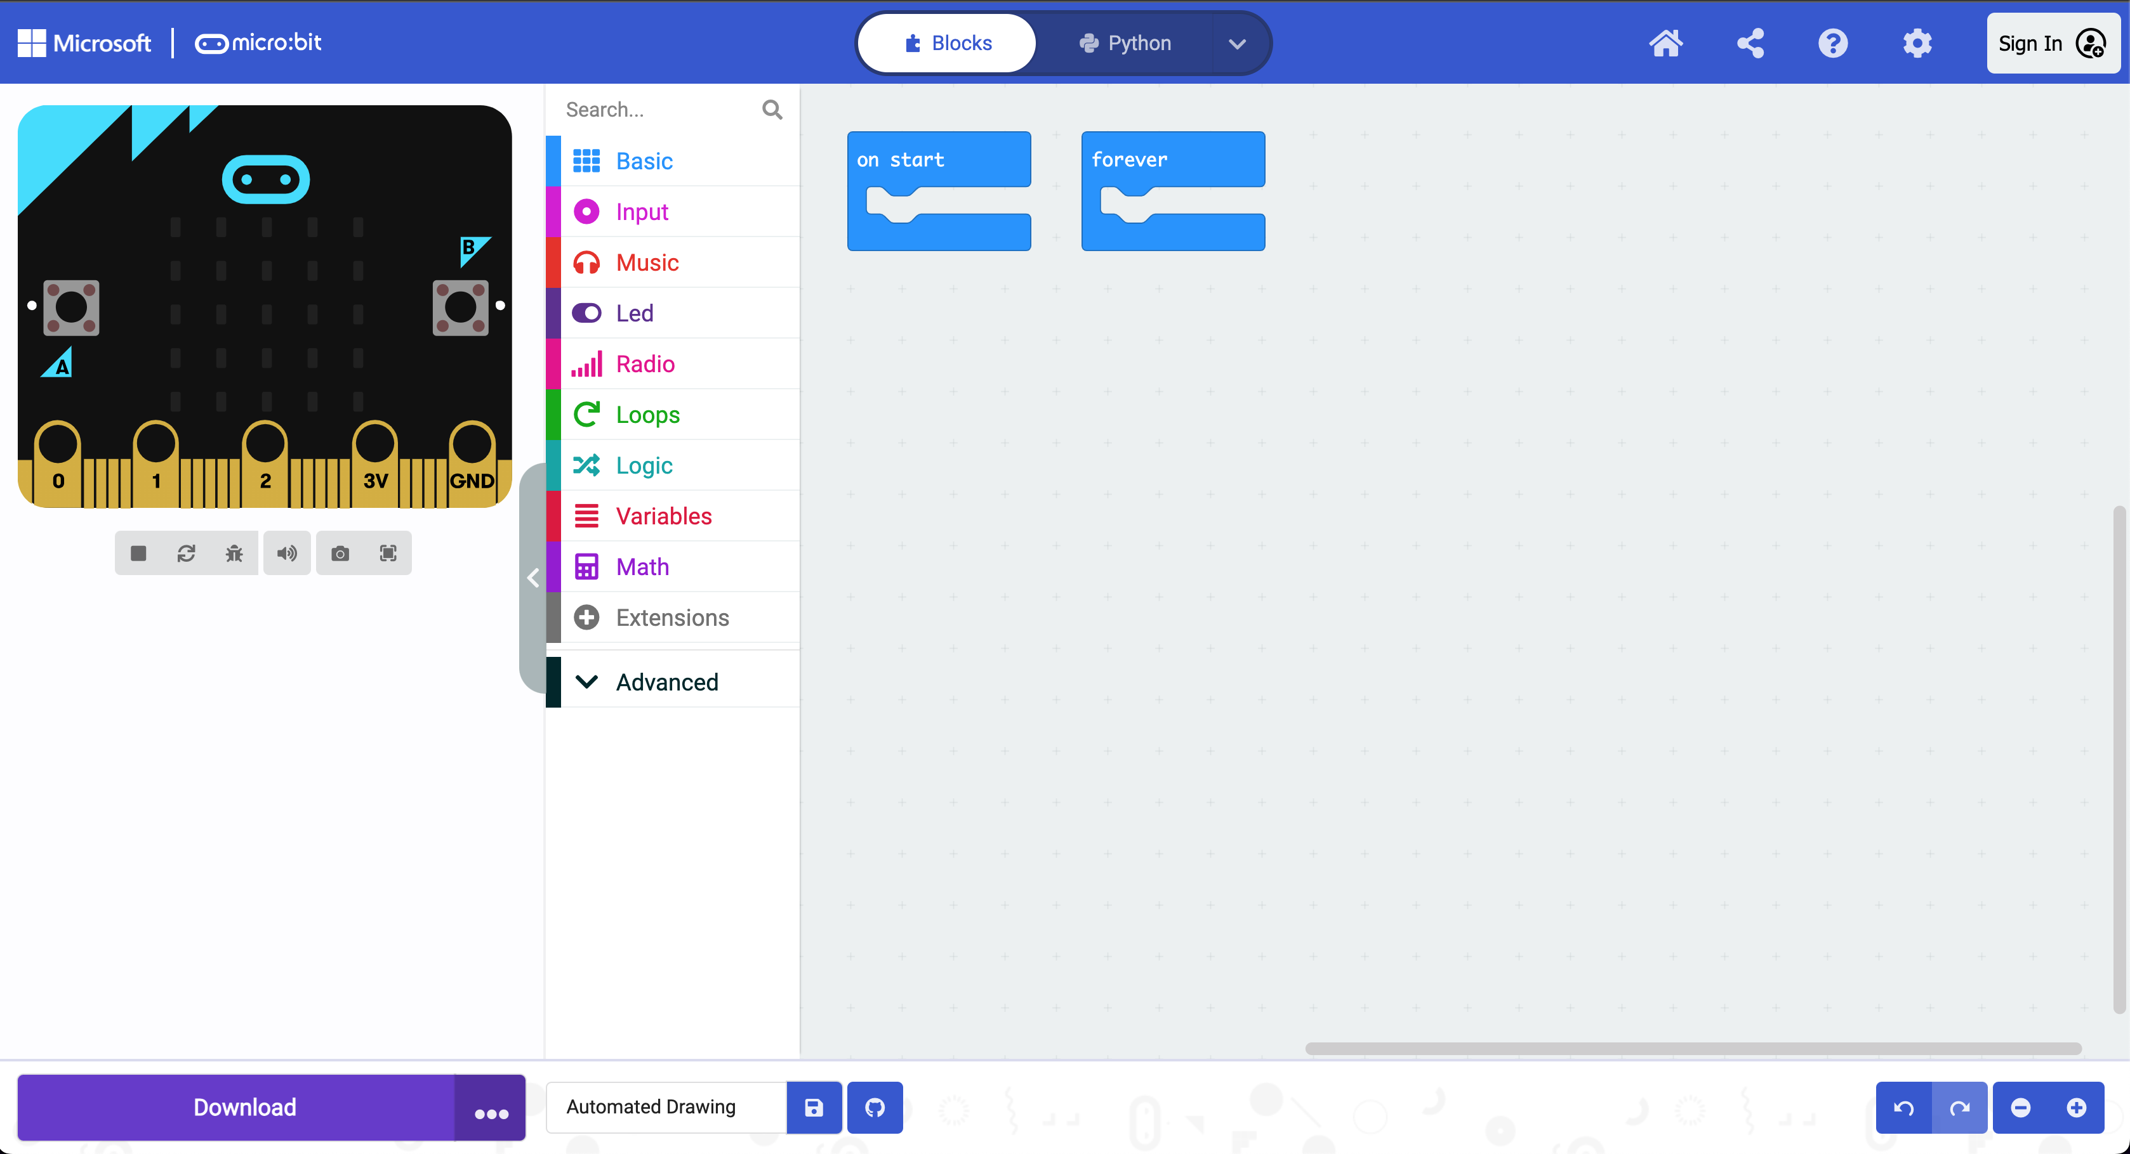
Step 1: Getting Started:
Select Extensions

Slide 3
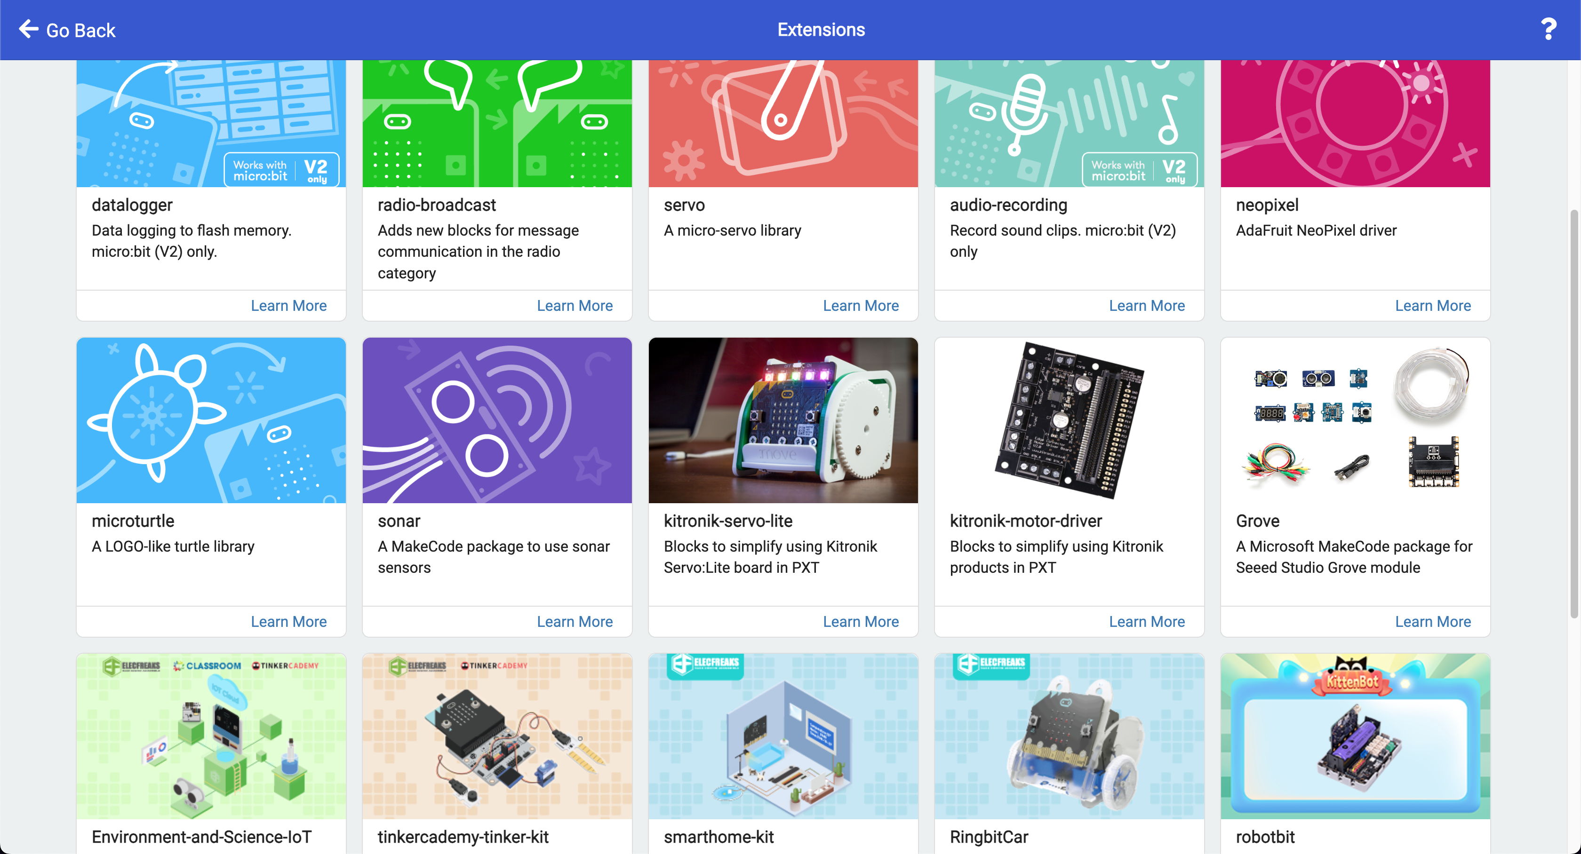
Step 2: Select microturtle

Slide 4
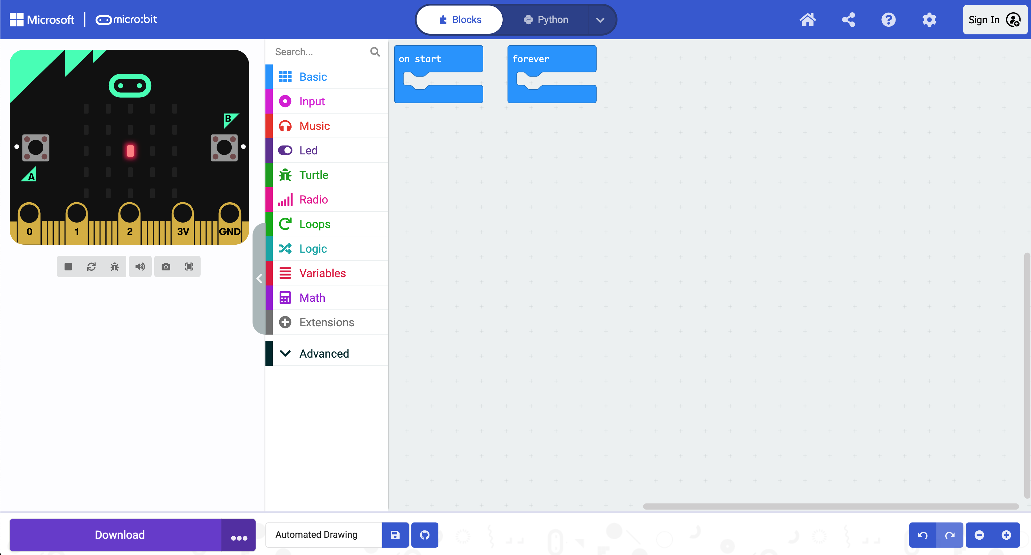
Step 3: Confirm Turtle is added
Turtle Functionality now added!

Slide 5
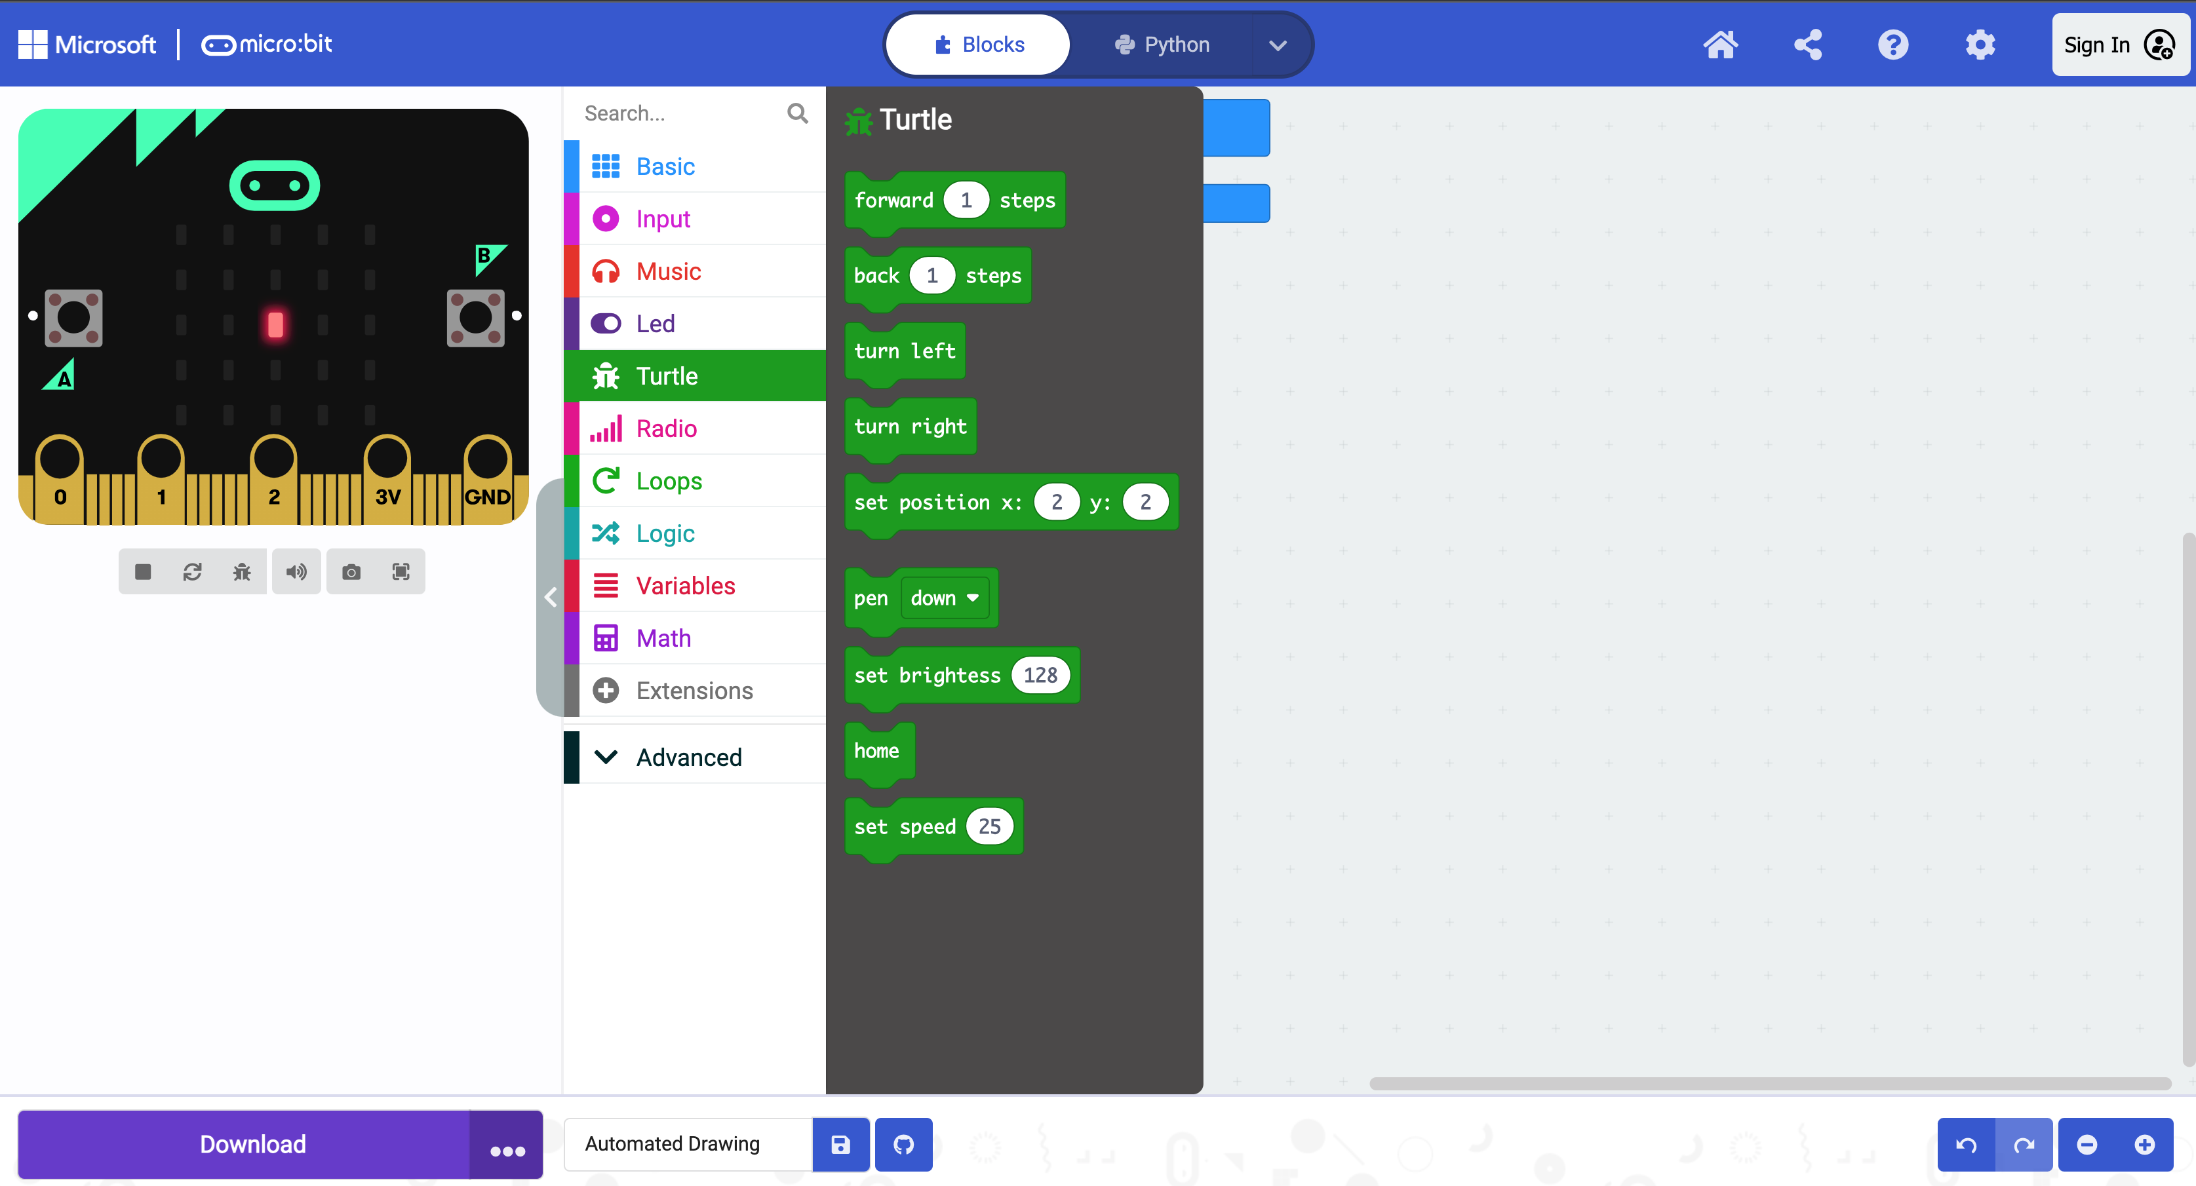
Step 4: Select Pen Down
Select Pen Down

Slide 6
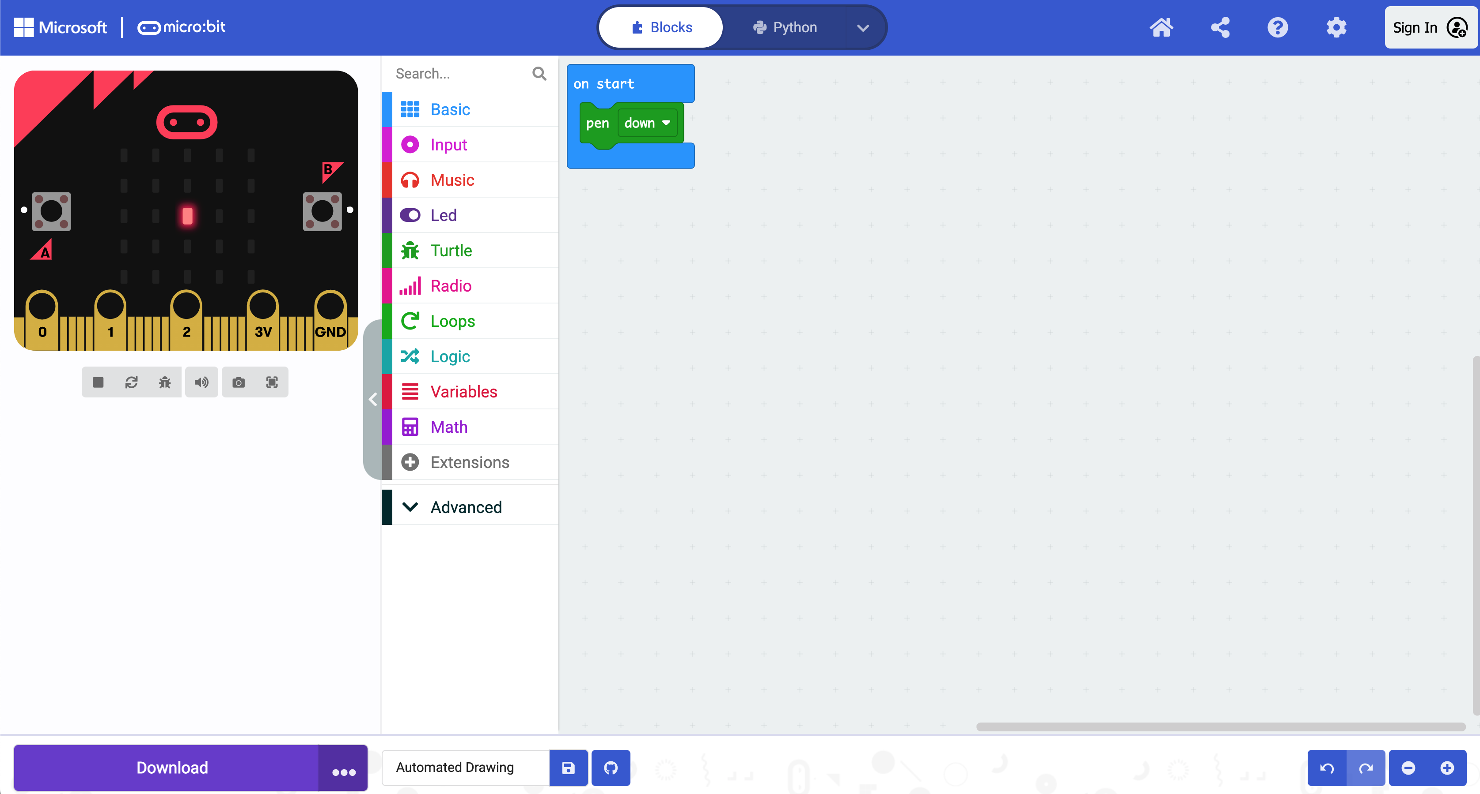
Step 5: Place in “On Start” block
Place inside “On Start” block

Slide 7
Step 6: Select Input
Select Input

Slide 8
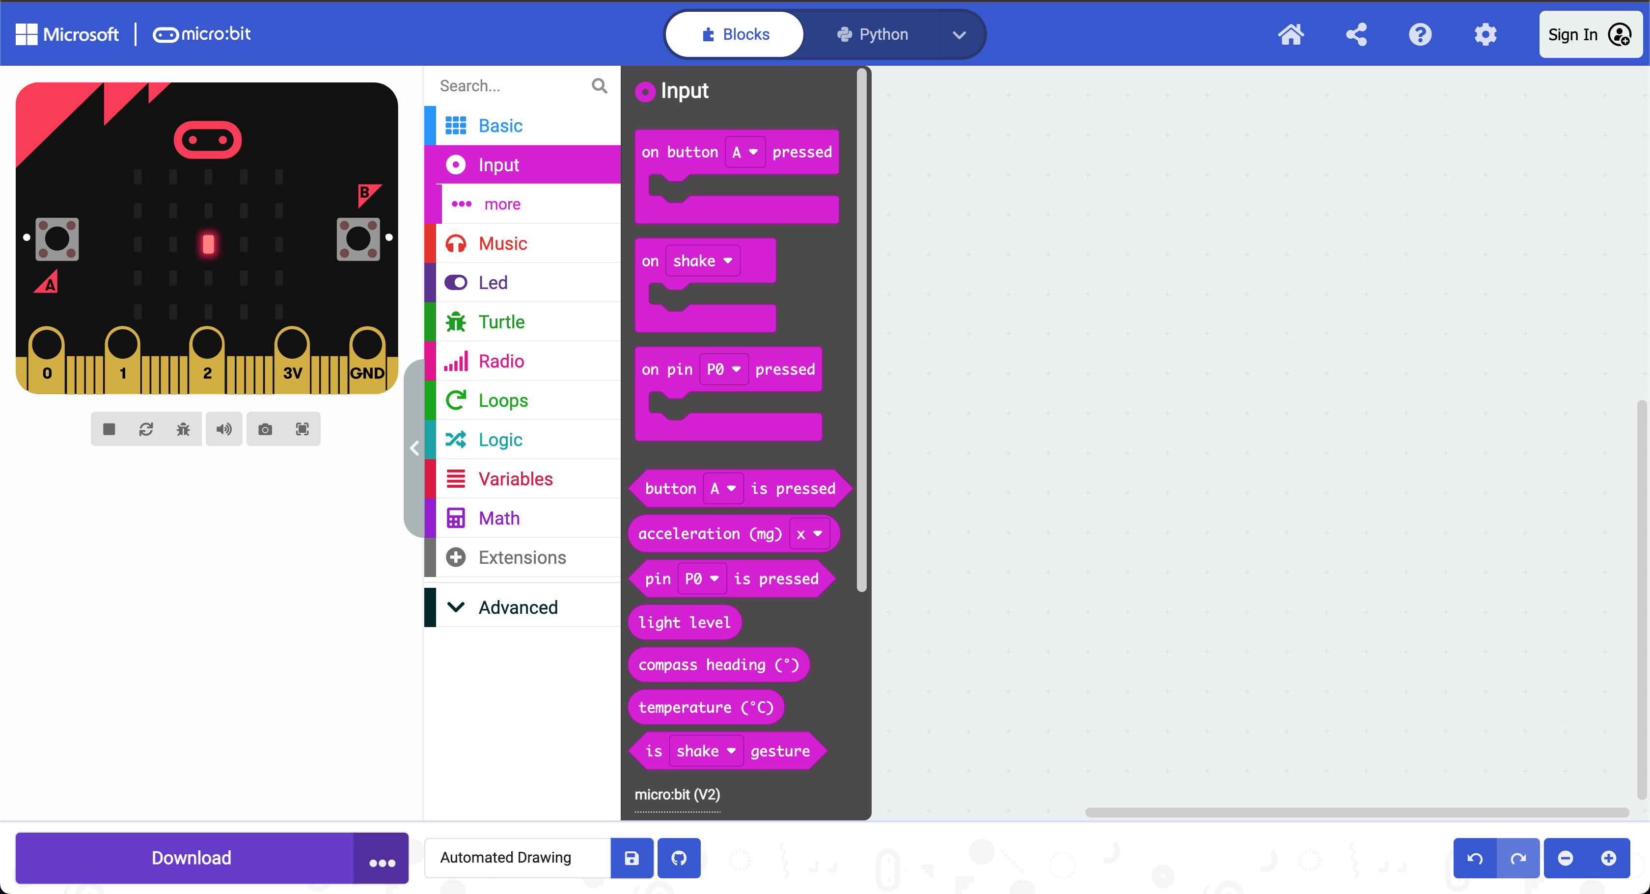
Step 7: Select on button pressed
Select 3 On Button pressed blocks

Slide 9
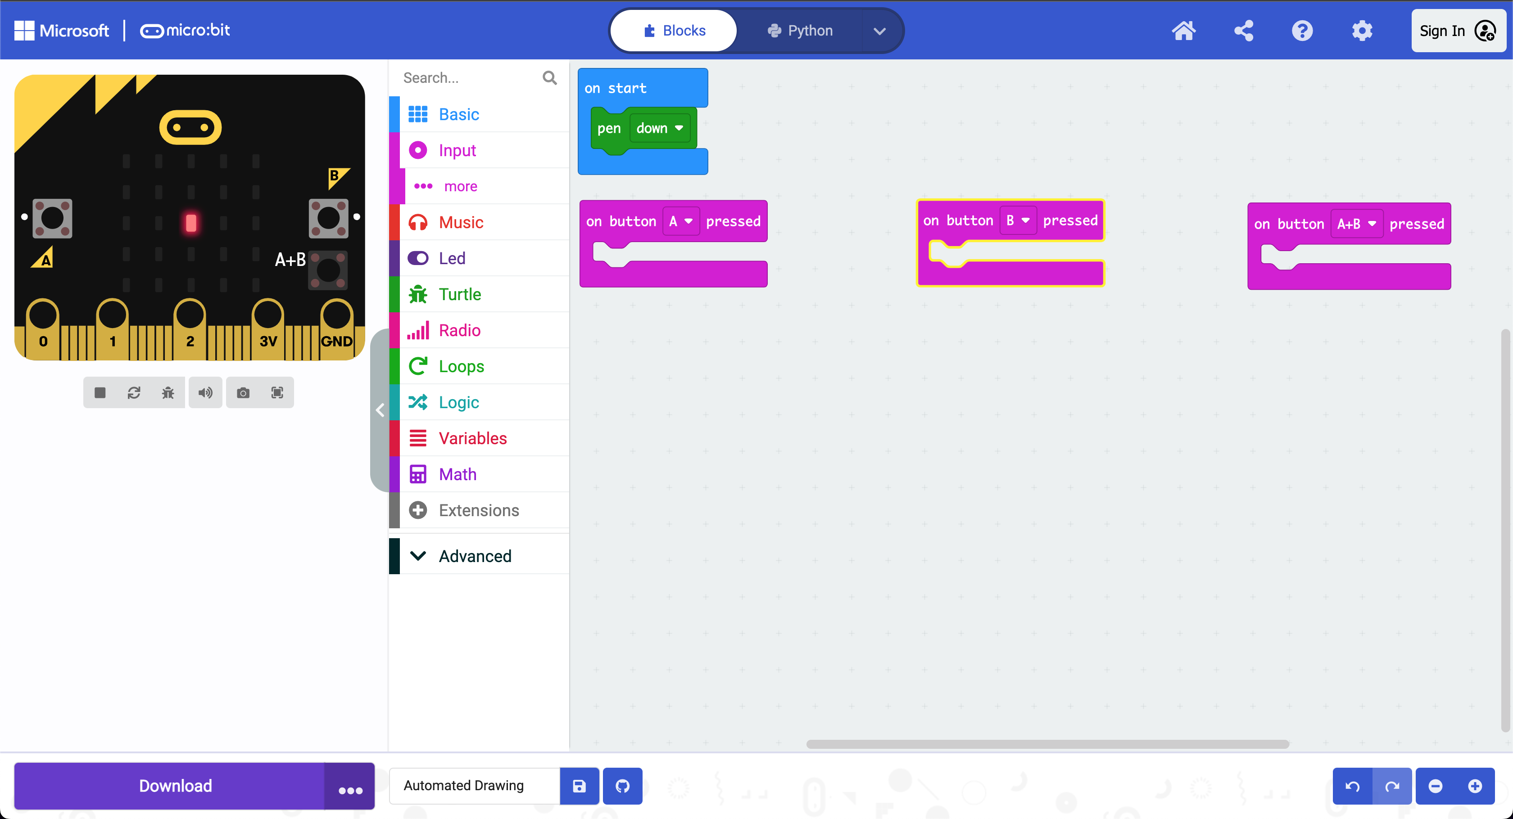
Step 8: Change button pressed
Option “B” selected
Option “A” selected
Option “A+B” selected

Slide 10
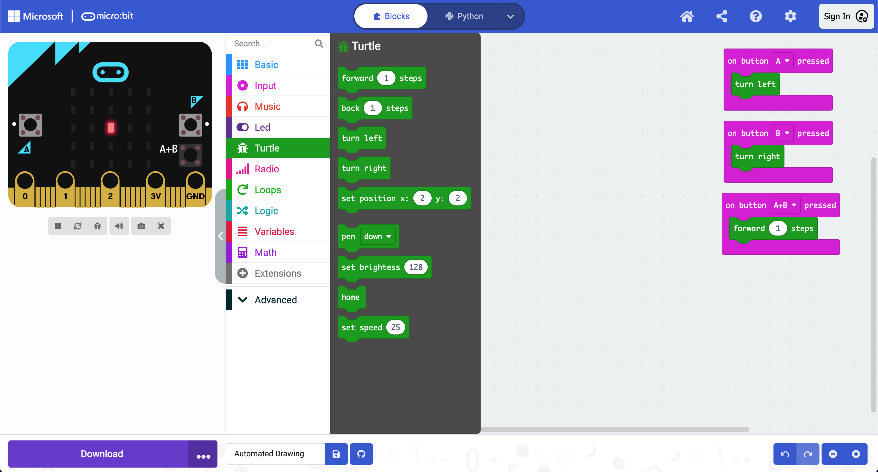
Step 9: place turtles in blocks

Slide 11
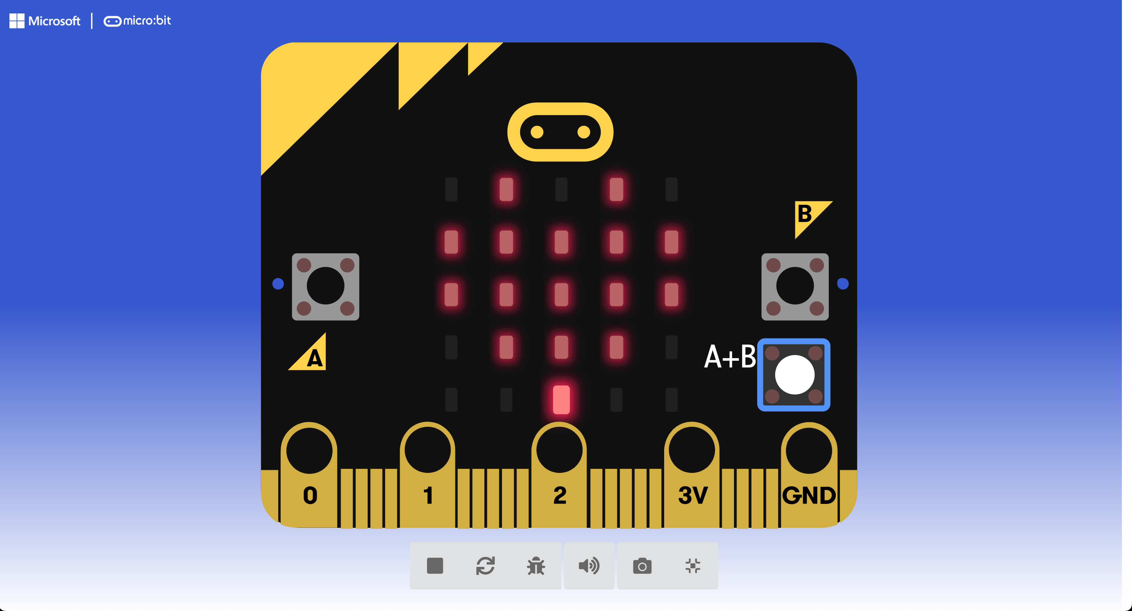
Step 10: Start Drawing!

